Slide 1
Road ahead
Series Convergence Strategy (11.7)
Divergence Test (11.2)
Test p-series or geometric (11.2/3)
Comparison Test (11.4)
Alternating Series Test (11.5)
Ratio Test (11.6)
Root Test (11.6)
Integral Test (11.3)

Slide 2
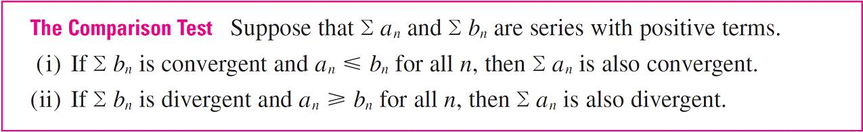
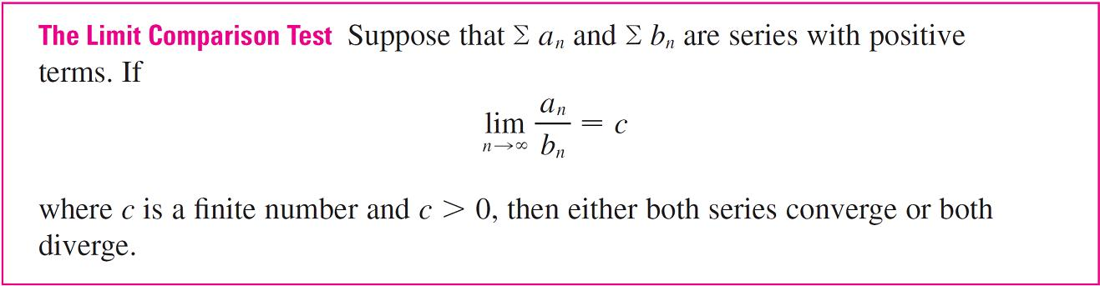
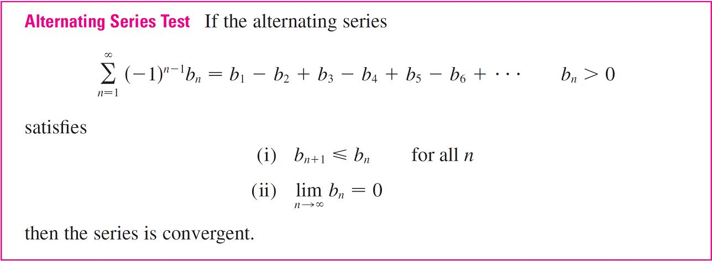
Review

Slide 3
Math 152
Lesson | Topic | Reading
28 | Comparison tests/alternating series | 11.4/11.5
29 | Absolute Convergence, Ratio & Root Tests | 11.6
30 | Power Series/Representation of Functions as Power Series | 11.8/11.9
Objectives:
Explain ABSOLUTE CONVERGENCE of a series
Recognize how and when to apply the Ratio & Root Tests
Use Ratio and Root Tests to show convergence/divergence

Slide 4

Absolute Convergence

Slide 5
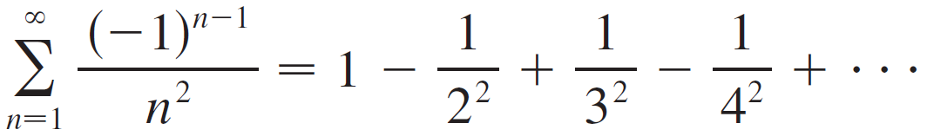
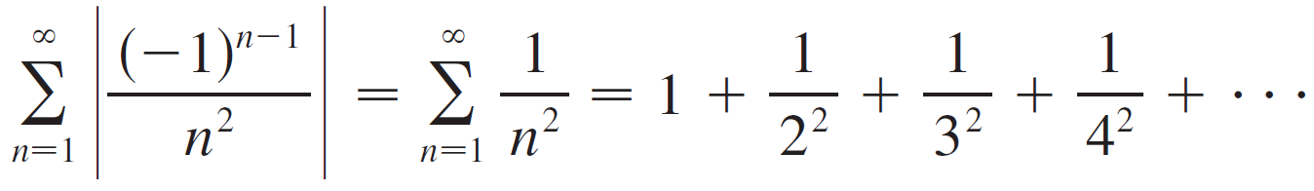
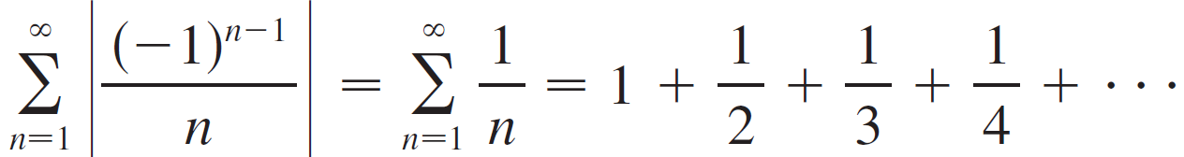
Example
is a convergent p-series (p = 2)
is the harmonic series (p-series with p = 1) and is therefore divergent

Slide 6
Ratio Test

Slide 7
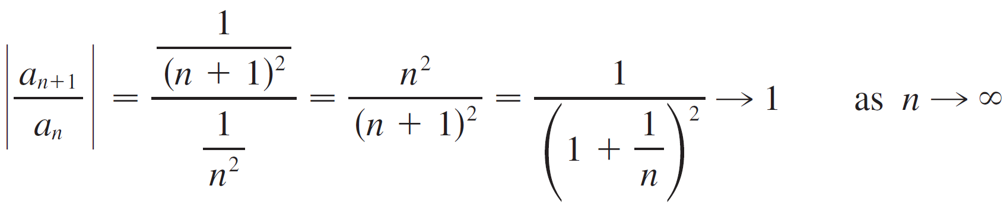
Ratio Tests
Note: Part (iii) of the Ratio Test says that if the test gives no information. For instance, for the convergent series Σ 1/n² we have
We know this converges because p>1

Slide 8
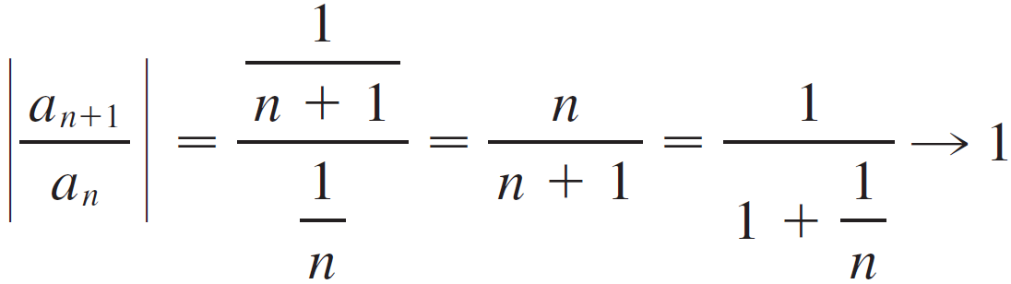
Ratio Test
whereas for the divergent series Σ 1/n we have
Therefore, if the series Σ a_{n} might converge or it might diverge. In this case the Ratio Test fails and we must use some other test.
We know this diverges because p = 1

Slide 9
Root Test

Slide 10
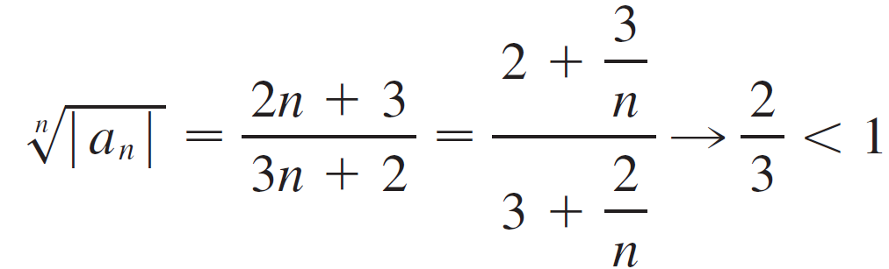
Example
Test the convergence of the series
Solution:
Thus the given series converges by the Root Test.

Slide 11
Desk Work
Comparison Test
Alternating Series
Ratio/Root Test

Slide 12
Comparison Test

Slide 13
Alternating Series

Slide 14
Root/Ratio Tests

